Slide 1
Arduino Basic Components
By: Jerry

Slide 2
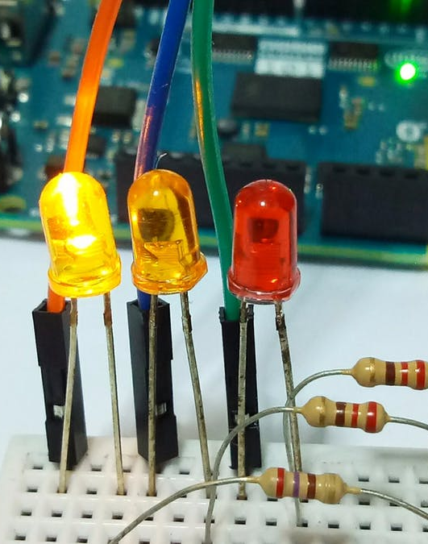
#1: LED
LED stands for light-emitting diode, this is one of the most basic electronic parts as it is basically just a light that can flip on or off.
It has two metal rods, one long, one short, be sure to have the order right when connecting these to female wires.

Slide 3
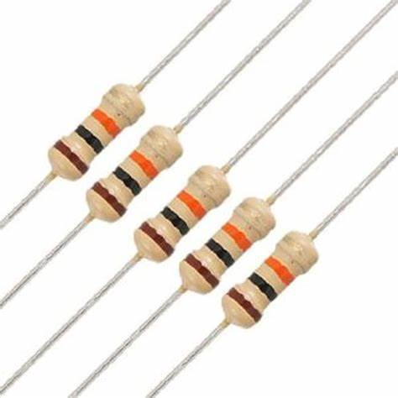
#2: Resistor
A resistor is a very useful component, It slows the voltage rate and therefore allows many circuits to work.
If it were not for this, many LEDs would be blown up.
Resistors have two metal rods poking out from both sides, and they also have a center that slows(resists) the flow of electricity.
They are used in almost any circuit.

Slide 4
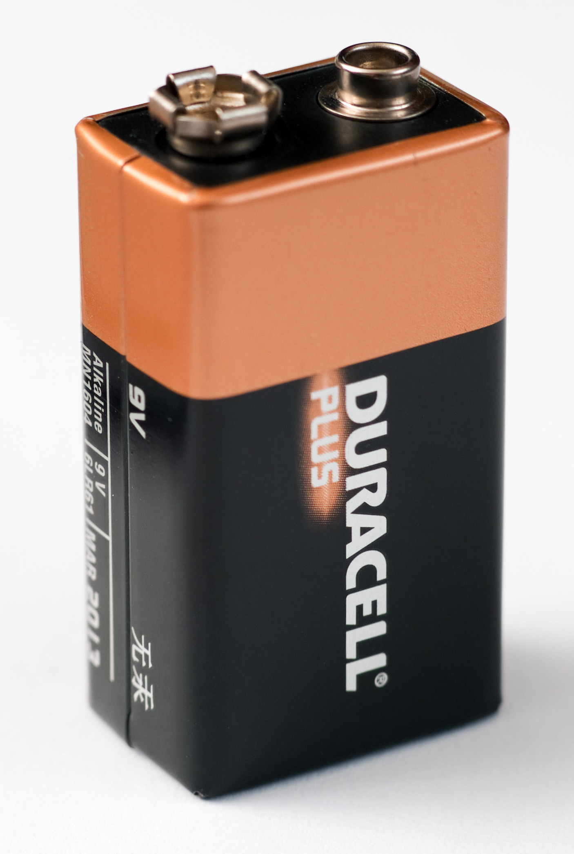
#3: 9v Battery
A 9V battery powers the Arduino, it contains all the electricity and is usually the main source of power in a circuit.
It contains the main body, and the 2 wire connectors.

Slide 5
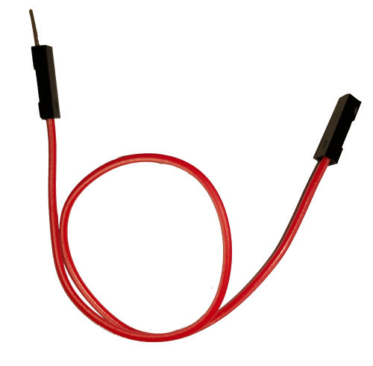
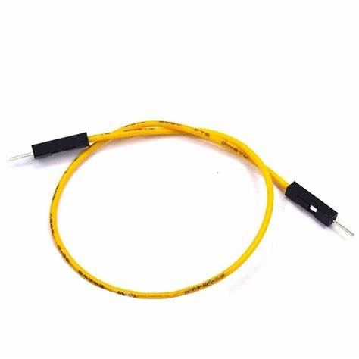
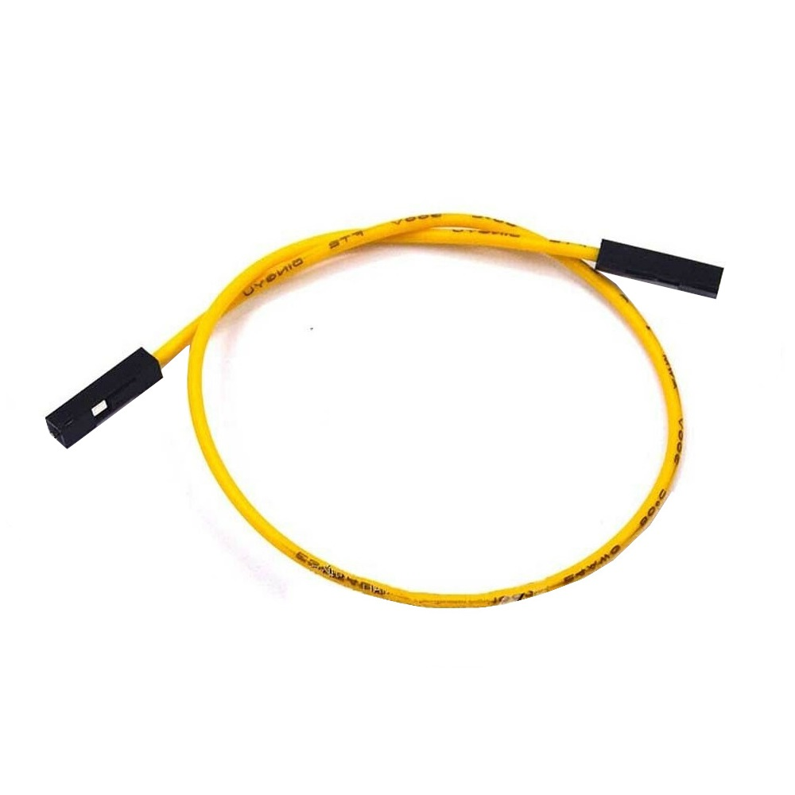
#4: Wires
FEMALE-MALE
MALE-MALE
FEMALE-FEMALE
Wires are one of the most important aspects of ANY Arduino circuit. Wires are like the blood vessels in your body.
There are 3 types: female-male, male-male, and female-female.
Wires comprise of a copper wire surrounded by rubber and the tips.

Slide 6
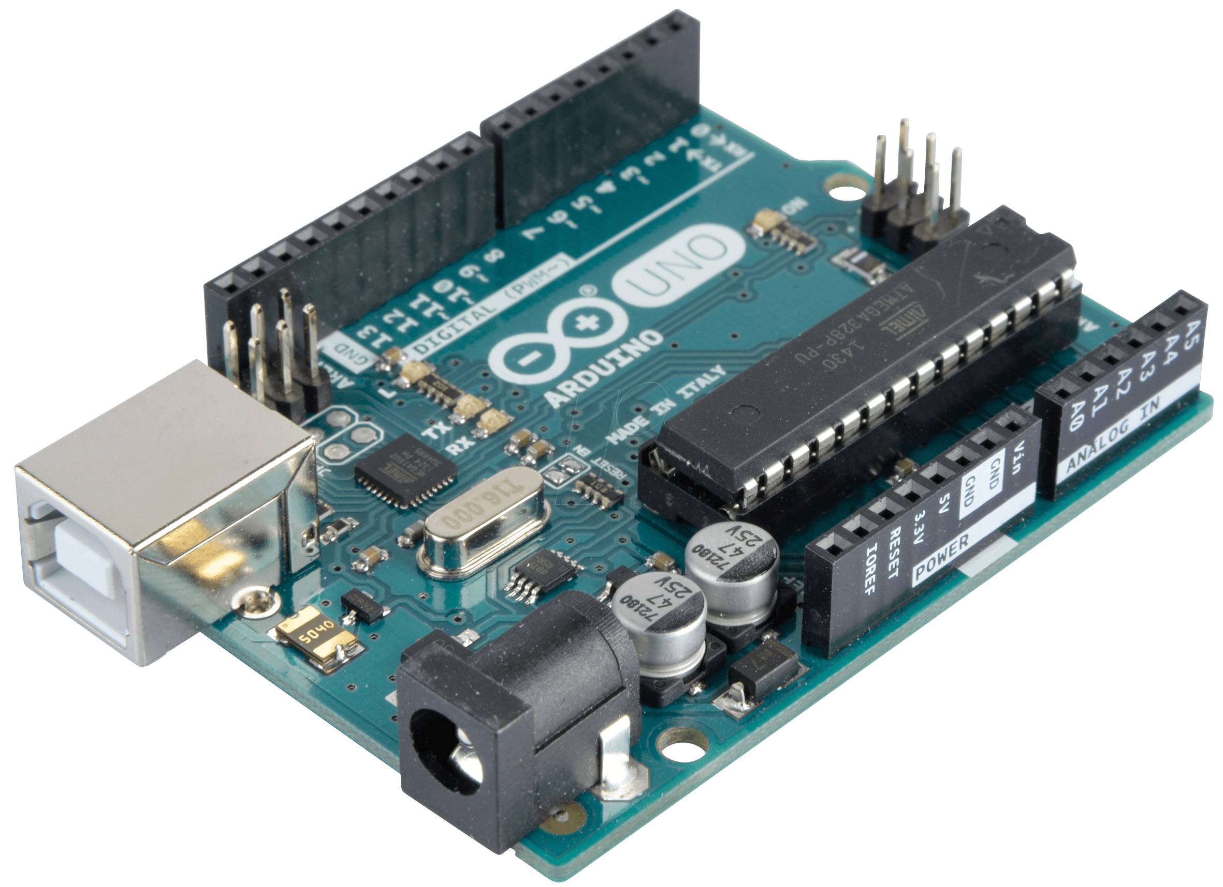
#5: Arduino Uno
The Arduino Uno is used for many projects. Think of it as the brain of the program.
It contains a USB port, so it must be connected to a computer.
It has many wire ports to, as well as many other electronic parts, It also contains a 9v Battery port.

Slide 7
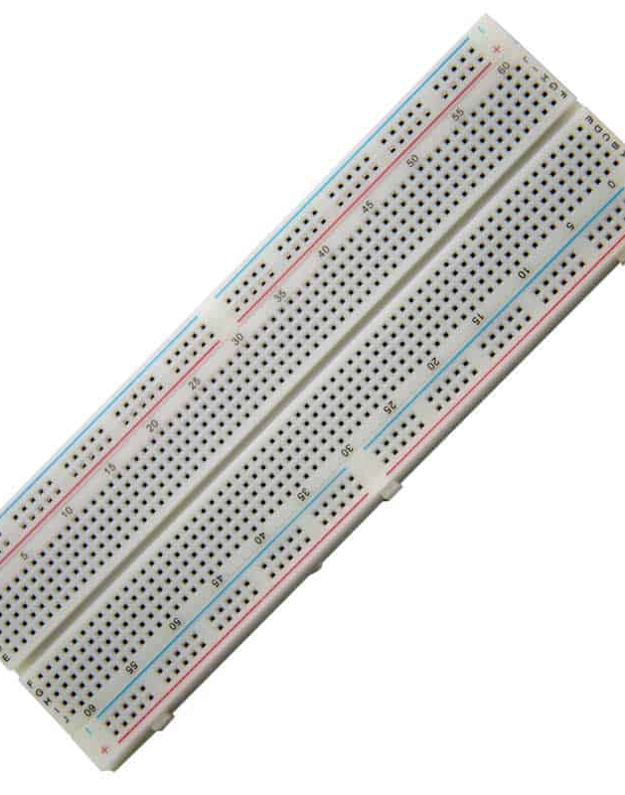
#6 Breadboard
The Breadboard is special because you don’t need to connect wires to any components for the circuit to work.
It has many wire port holes, which LEDs, resistors, and many other things can fit in.

Slide 8
THANK YOU FOR WATCHING

